Slide 1

South Region
Gas Regional Investment Plans
SGRI – 23 September2013

Slide 2
GRIP South
Index
  Perimeter / objectives
  Methodology / Content
  Planning
2

Slide 3
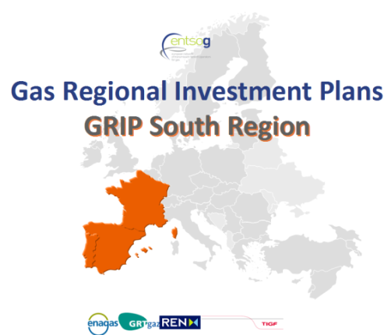
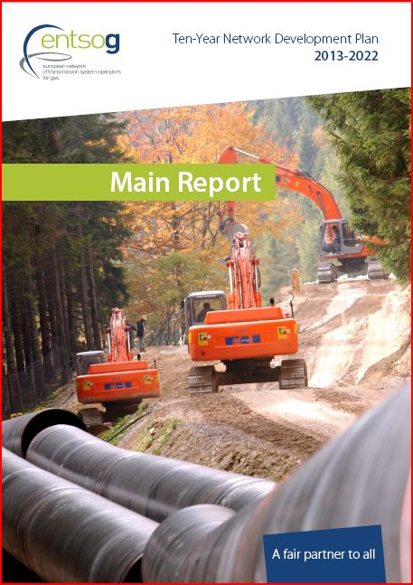
Perimeter /Objectives
3 Countries (FR, SP, PT) and 4 TSOs
Main drivers/objectives
Complementing EU-TYNDP
Consistent with National Plans
Taking into account feedbacks received on GRIPs:
  → More harmonization (with ENTSOG assistance)
  Improve communication and consultation
  More comprehensive approach on the system needs and remedies (projects) / TYNDP
  updated information / TYNDP
EU energy policy, “Trans-European energy infrastructure” (12/03/13)
“The strategic concept of the North-South Corridor in Western Europe, that is to better interconnect the Mediterranean area and thus supplies from Africa and the Northern supply Corridor with supplies from Norway and Russia.” (EC, EIP for 2020)

Slide 4
Methodology
  Regulation, previous GRIP, Feedbacks received
  GRIPs harmonization and ENTSOG guidance:
    TYNDP 2013-2022
    Updates on Demand and Projects organized at EU level,
    Additional modelling with ENTSOG tool,
    More homogeneity of the GRIPs contents (+ regional specificities),
  Consultation of stakeholders
    SGRI meetings
    ENTSOG Workshop dedicated on GRIPs (19th November)
    Consultation on the draft document (to clarify)
4

Slide 5
Methodology
  Network assessments / remedies
    More detailed analysis of the needs / TYNDP assessment
    Additional assessments: other modelling, IPs capacity subscription, Hub price spreads analysis (to confirm), interconnections utilization rates (to confirm), market consultations (OS)...
    Remedies : focus on the projects answering to the needs identified in the network assessment
  Updated information / TYNDP 2013-2022
    Information on projects will be updated
    Demand information will be updated
    To address : update of the results (i.e. Assessments)
5

Slide 6
Content
  Introduction
  Demand: analysis of the demand in the South region
  Supply: analysis of the assets and the needs of the Region
  Projects (capacities evolution): analysis of the projects in the South Region
  Network assessments:
    In-depth analysis of the TYNDP assessments
    Other assessments /analysis
  Remedies:
    In-depth analysis of projects answering to needs identified in the chapter “Network assessment”
  Conclusion
  Appendices : updated data / TYNDP
6

Slide 7
Planning
  TSOs meetings : from October 2012 ...
  ENTSOG TYNDP publication : 21st February 2013
  Writing of the new GRIP : from February 2013 ...
  Stakeholders communication / consultation:
    GRI South meeting(s) : IG & SG meetings
    ENTSOG meeting(s) : Workshop (19th November)
    Consultation : (to confirm/clarify)
      Regulators : on a “final” draft
      Other stakeholders : on the published document
  Publication : end of 2013
7

Slide 8
Thank you for your attention

